Slide 1
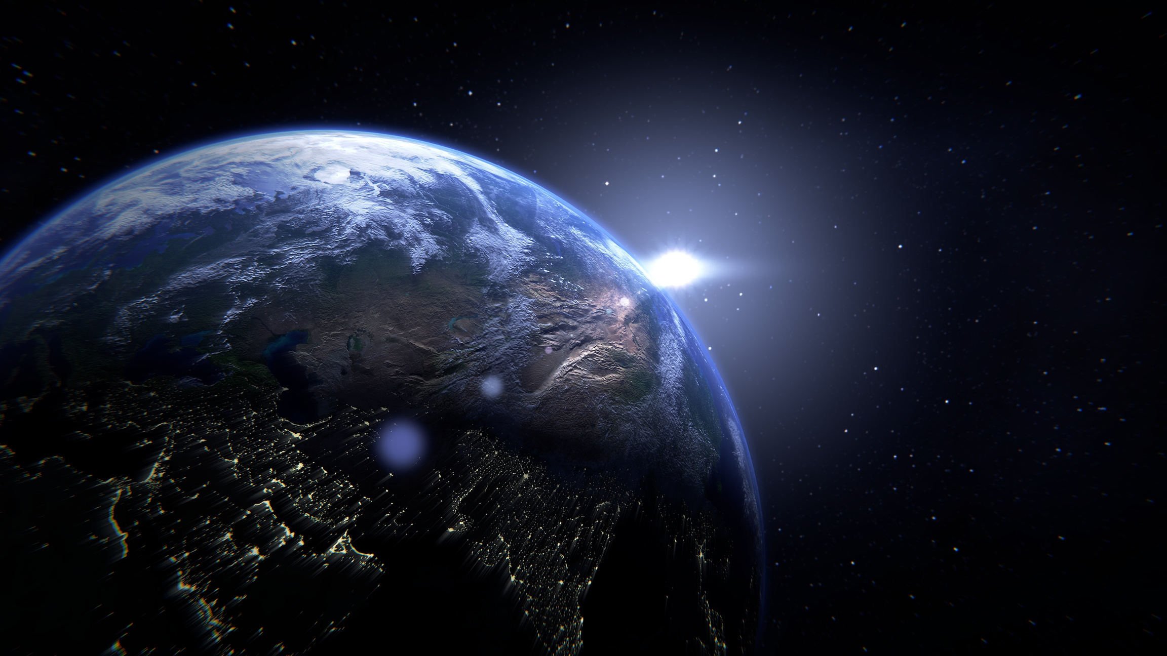


EXOPLANETS
YOU DON’T KNOW ABOUT OUTER SPACE

Slide 2

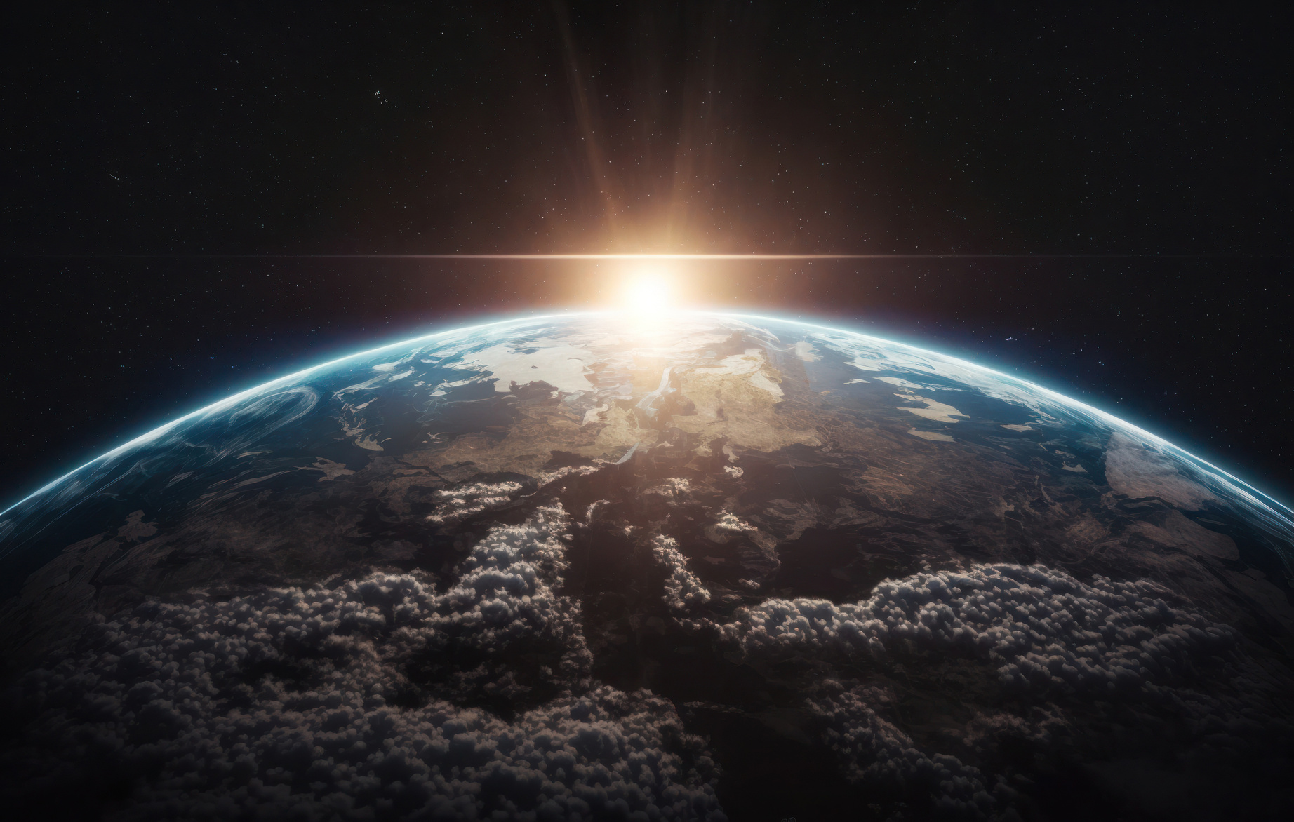
WELCOME TO OUR SOLAR SYSTEM
About Solar System
The solar system consists of the Sun and the objects that orbit it, including eight planets—Mercury, Venus, Earth, Mars, Jupiter, Saturn, Uranus, and Neptune. It also contains moons, asteroids, and comets, all bound by the Sun's gravity. The solar system is part of the Milky Way galaxy and continues to be explored for insights into planetary origins and life beyond Earth.
About Galaxy
A galaxy is a massive system of stars, planets, gas, dust, and dark matter bound together by gravity. Our galaxy, the Milky Way, contains billions of stars, including our Sun, and spans about 100,000 light-years across. Galaxies come in different shapes, such as spiral, elliptical, and irregular, and they are scattered throughout the universe. They are the building blocks of the universe, with billions of galaxies making up the vast expanse of space.

Slide 3
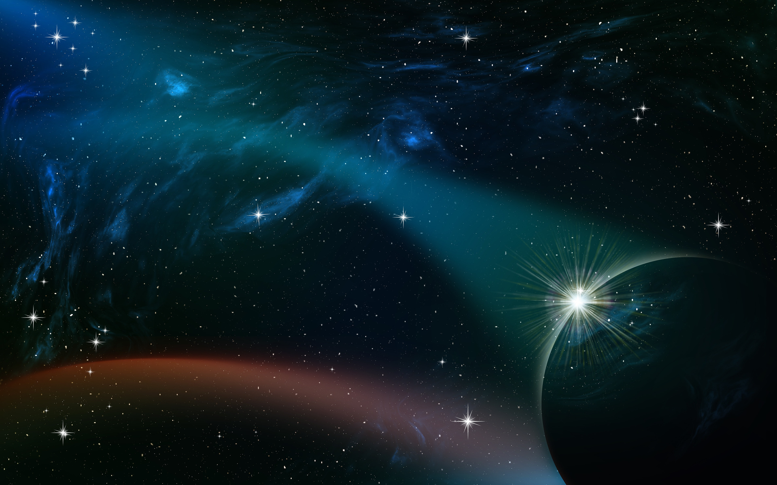
OUR VISION AND MISSION
•To make the exploration of distant worlds accessible to all.
01
To create an engaging mobile application that chronicles the history, present, and future of exoplanet discovery
02
To foster global awareness and interest in space exploration by making the science of exoplanets accessible and exciting, promoting a deeper appreciation for the vastness of the universe and humanity's place within it.
03

Slide 4
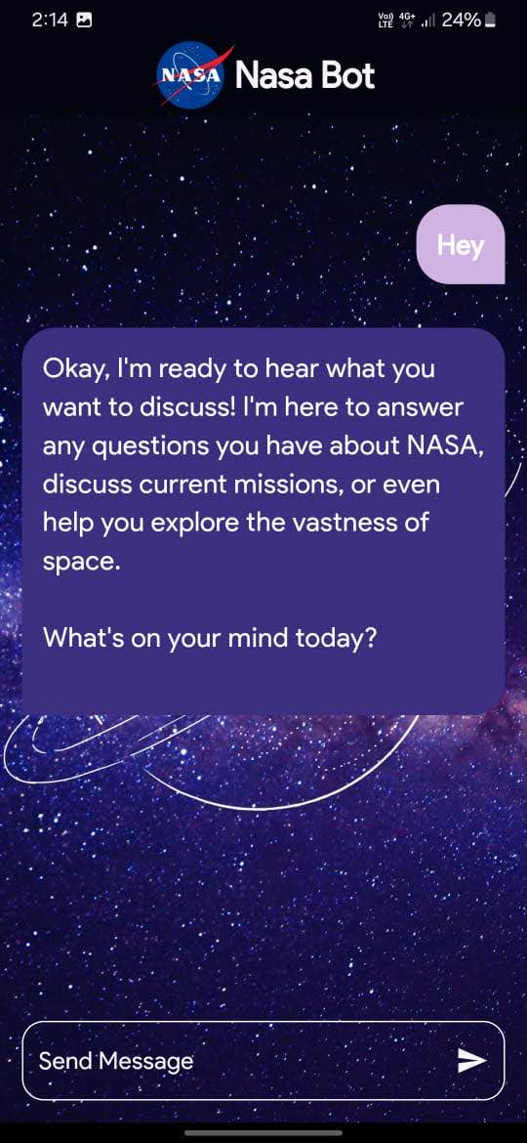
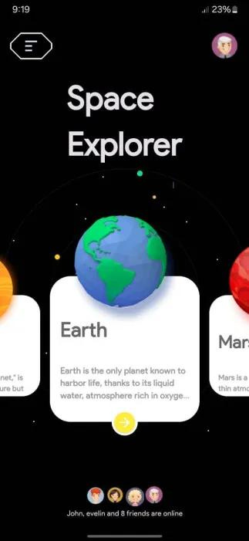
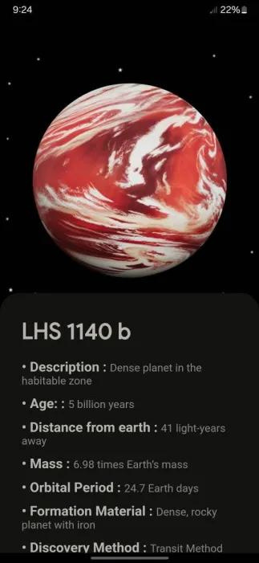
OUR APP
Engagement: Interactive features like quizzes and notifications keep users involved.
Educational Tool: Provides up-to-date information for students and space enthusiasts.
Community Building: Users can connect and share discoveries with others.
Data Visualization: Graphs and charts simplify complex exoplanet data.
Real-Time Updates: Push notifications about new discoveries and mission updates keep users informed.

Slide 5
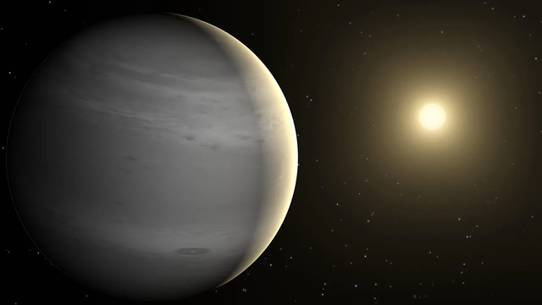
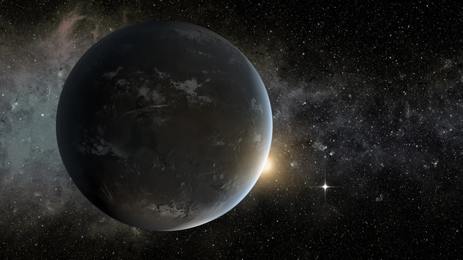
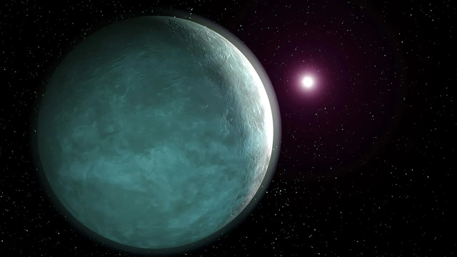
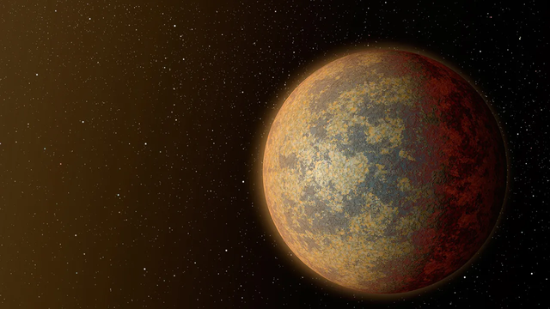
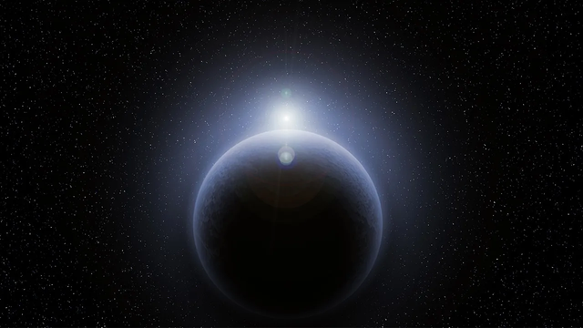
MEET TYPES OF EXOPLANETS
Gas Giants
Super-Earths
Neptunian
Terrestrial
Unknown

Slide 6
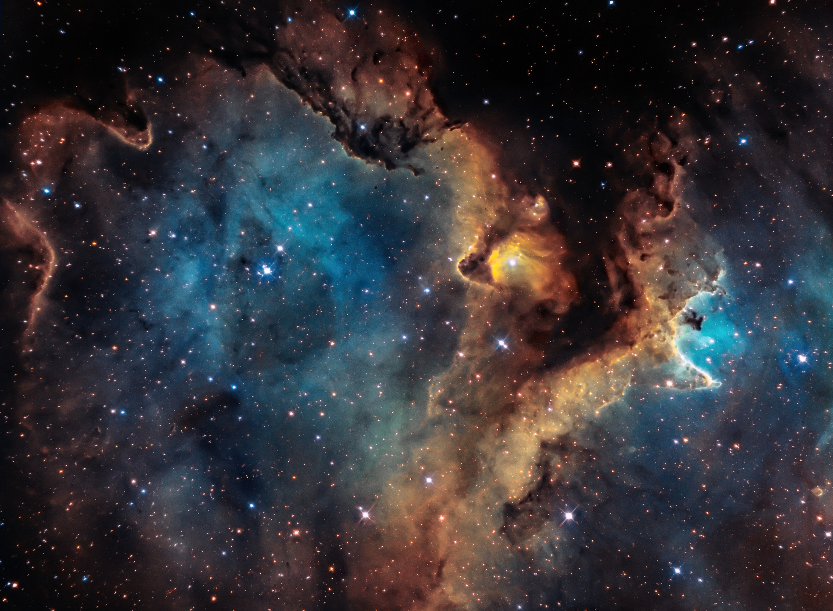
OUTER SPACE AND EXOPLANETS
•Humanity's journey to explore space has led to groundbreaking discoveries about planets beyond our solar system.
•
•Early Milestones: The launch of Sputnik in 1957 and the Apollo Moon landings set the stage for space exploration.
•
•Search for Exoplanets: The launch of the Kepler Space Telescope in 2009 was a turning point, discovering over 2,600 exoplanets.
•
•Next-Generation Exploration: The James Webb Space Telescope (2021) is providing deeper insights into exoplanets' atmospheres and potential for life.
•
•These missions fuel our curiosity, pushing the boundaries of where we might find habitable planets, and possibly, extraterrestrial life.

Slide 7
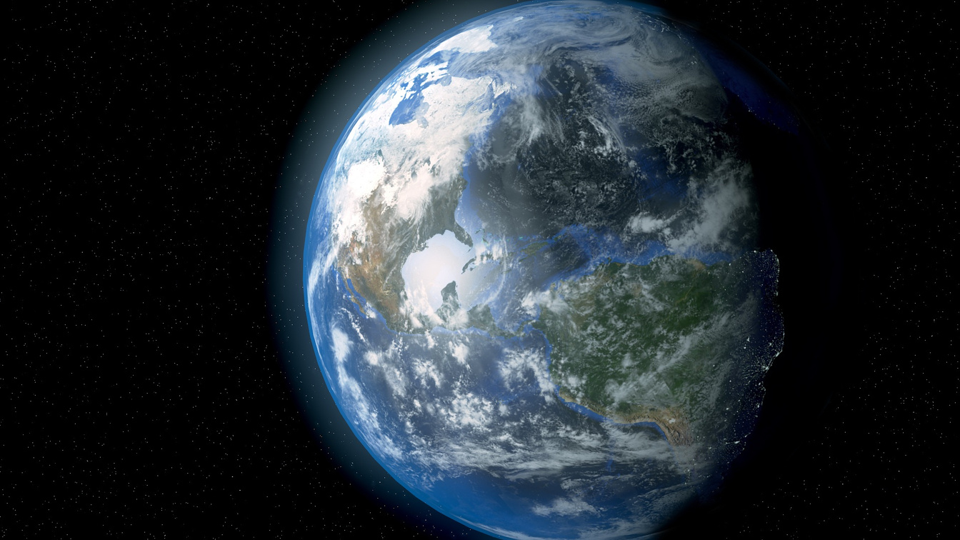
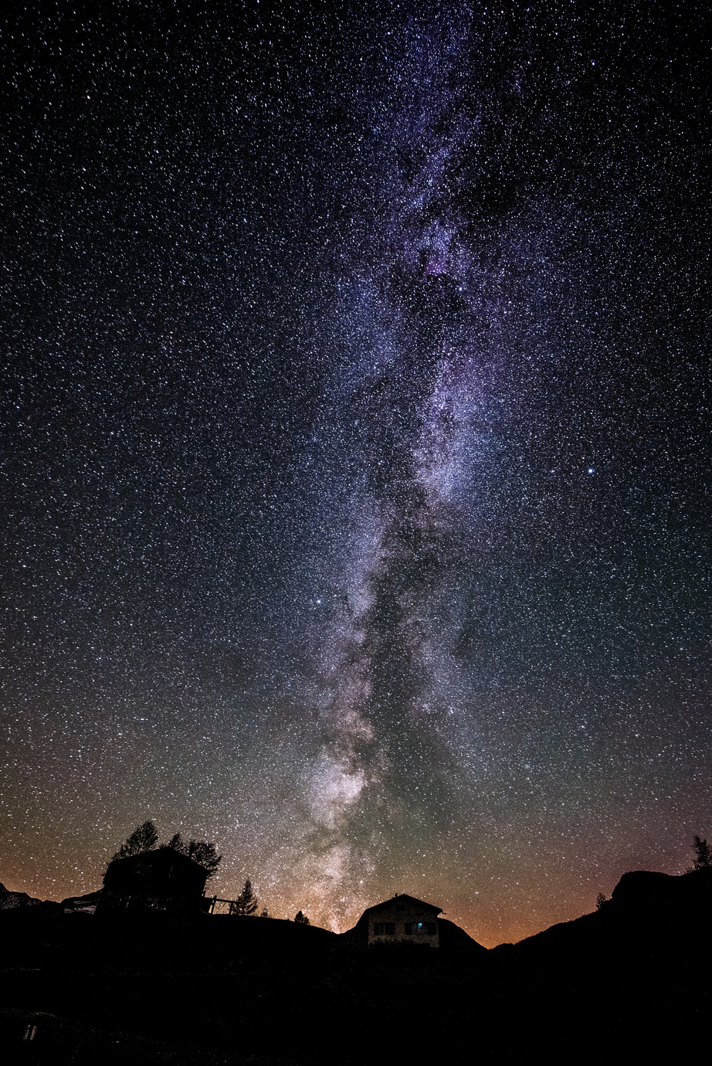
THANK YOU
We appreciate your time and interest in our project, C-SPACE .
Your support and feedback are invaluable in our mission to bring the wonders of exoplanets closer to everyone.
Special thanks to :
Our team for their hard work and dedication
NASA Space Apps Challenge for the opportunity
The Flutter community for providing powerful tools to bring our vision to life
Stay curious and keep exploring the universe with us!

